Slide 1
Agenda
1. NoSQL MongoDB
2. Cassandra
3. Graph: Neo4j
4. HDFS
5. IPFS
6. REDIS
7. Web Services

Slide 2
Programming Foundations: Databases ( NoSQL)
By Altotech

Slide 3
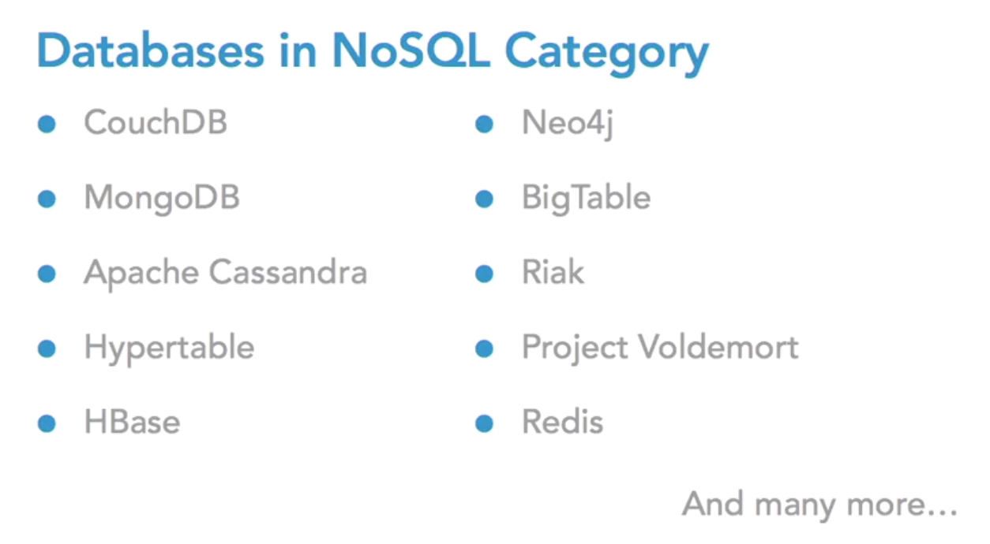

Slide 4
NoSQL Database
A NoSQL database has dynamic schema for unstructured data, and data is stored in many ways: it can be column-oriented, document-oriented, graph-based or organized as a Key-Value store.

Slide 5
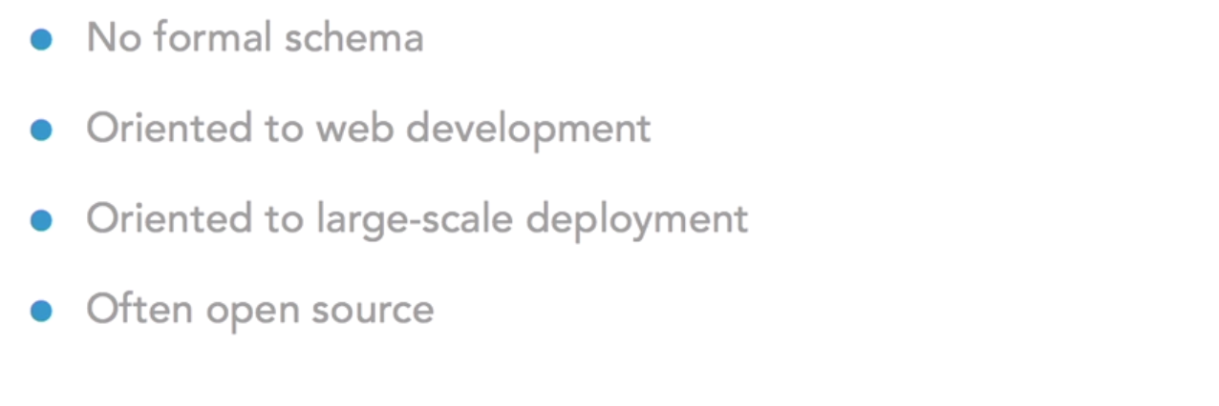
Features of NoSQL Database

Slide 6
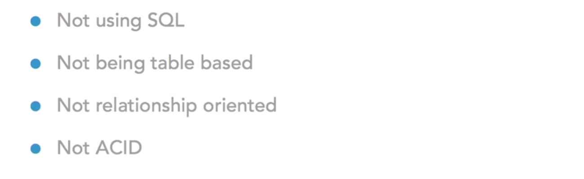
Features of NoSQL Database

Slide 7
Key benefits of NoSQL
Create a flexible and dynamic data model to store data
Scale your database operation without a major overhaul of data schema or strategy and without a dip in performance
Maximize IT infrastructure potential through efficient use of storage resources
Achieve big data levels of information storage
Support business applications with high availability

Slide 8
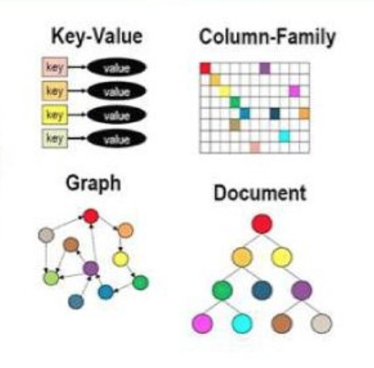
Types of NoSQL databases
Document
Graph
Key-Value
Column
...

Slide 9
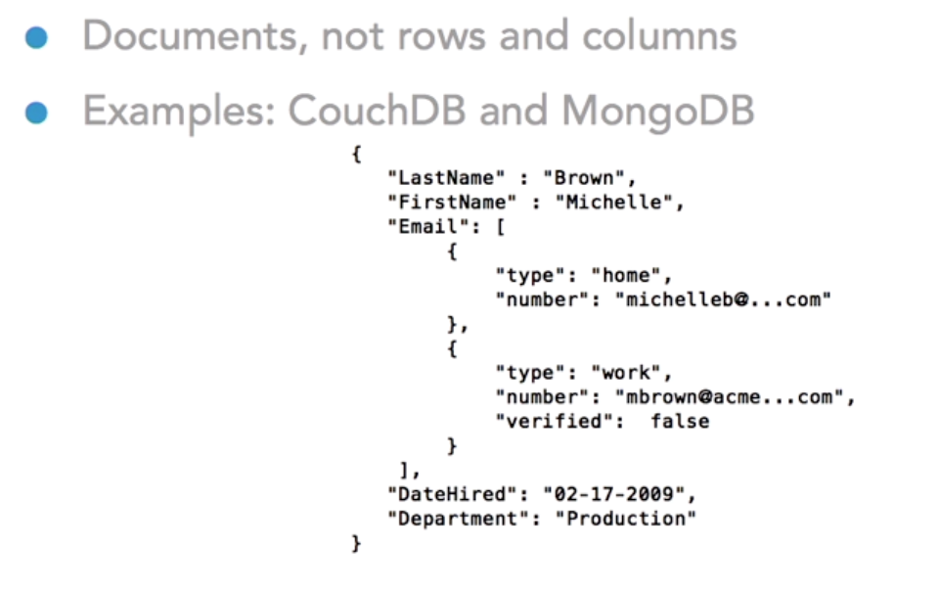
Document Store

Slide 10
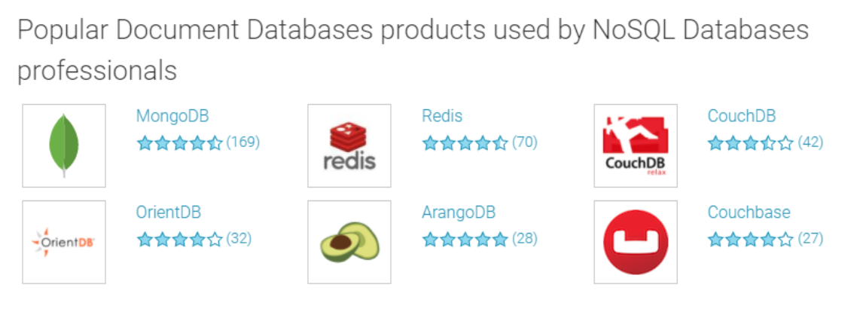

Slide 11
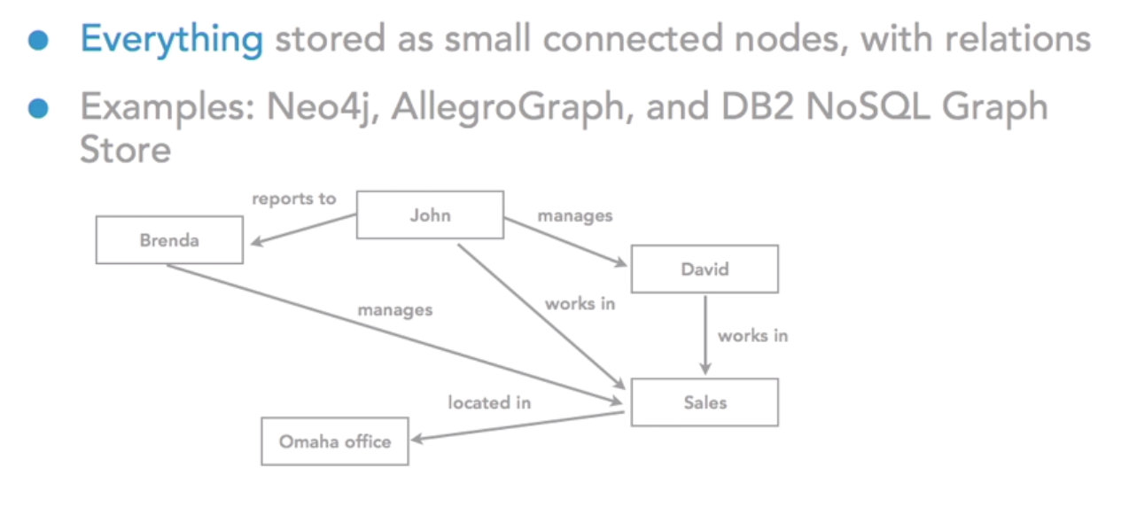
Graph Store

Slide 12
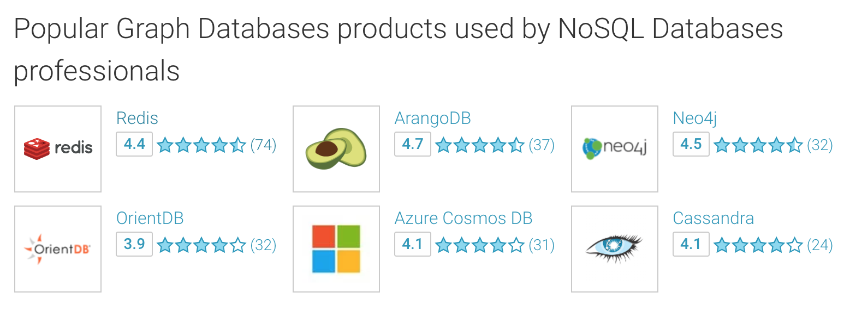

Slide 13
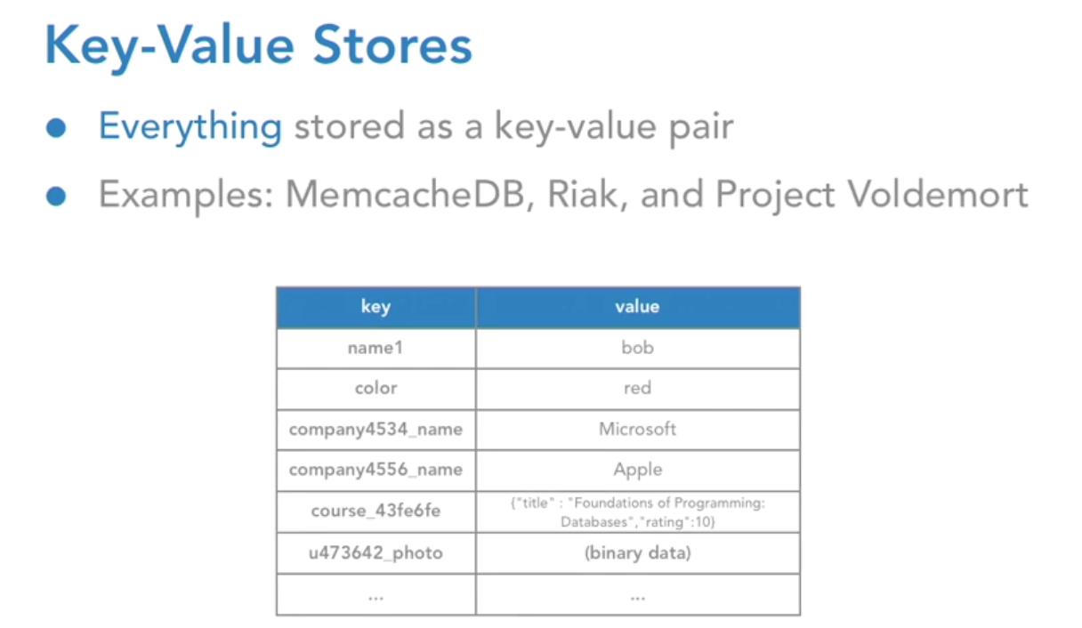
Key-Value Store

Slide 14
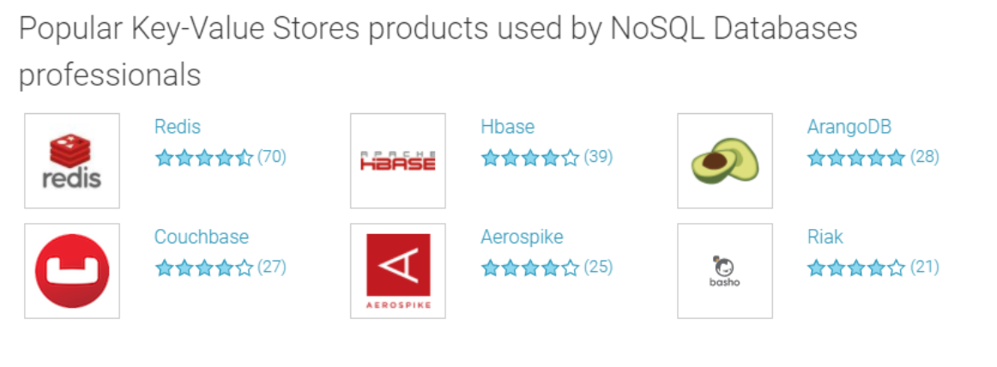

Slide 15
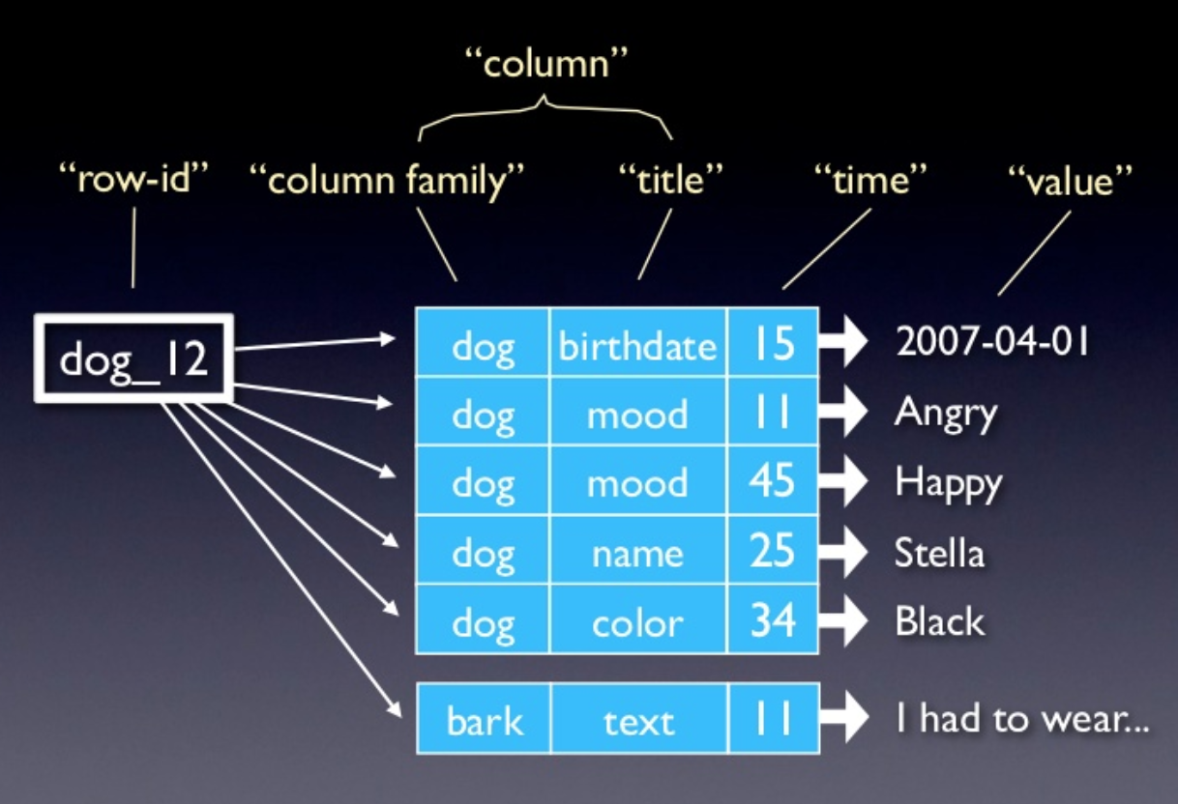
Column Store
Each key is associated with multiple attributes (i.e. Columns)
Hybrid row/column stores
Examples: Hbase, Cassandra

Slide 16
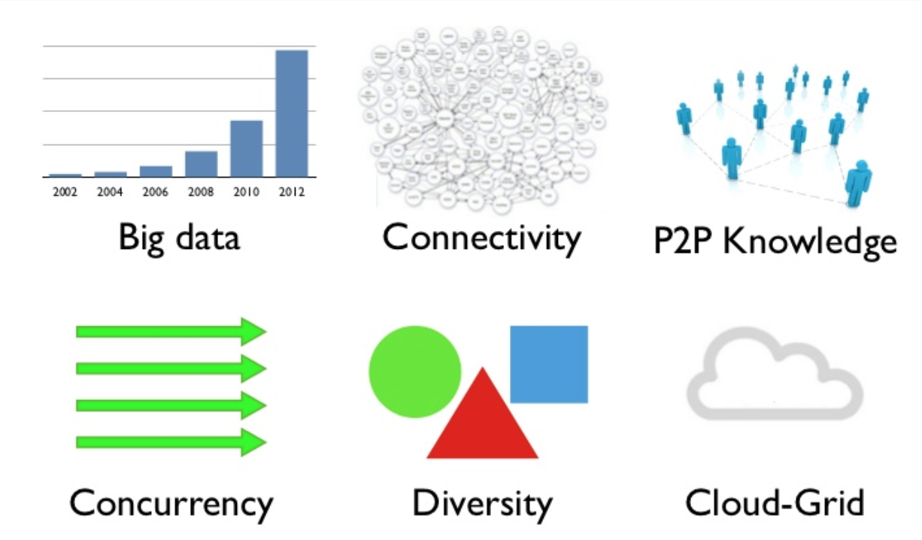
Why NoSQL?
Scalability
Concurrency
New Trends

Slide 17
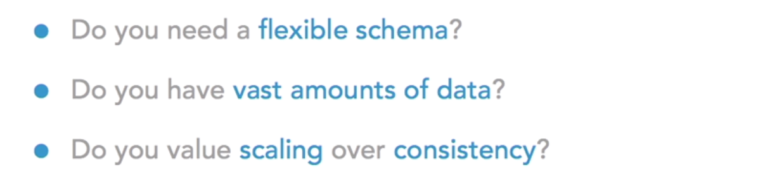
Reasons to Choose a NoSQL Database

Slide 18
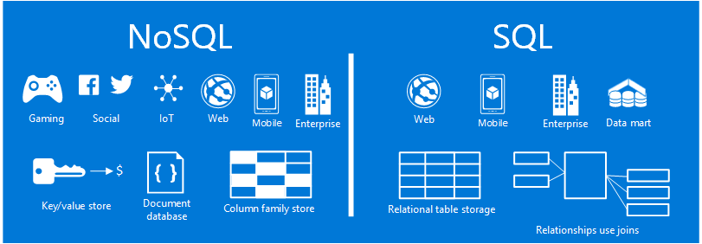
NoSQL vs SQL

Slide 19
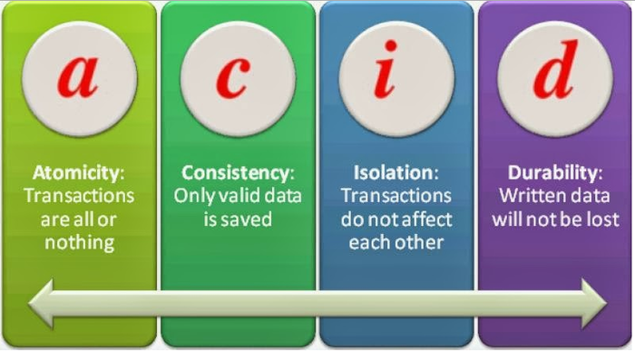
SQL Advantages
ACID (Atomicity, Consistency, Isolation, Durability) compliance reduces anomalies and protects the integrity of your database by suggesting precisely how transactions interact with the database. Often NoSQL databases sacrifice ACID compliance with processing speed and flexibility.

Slide 20
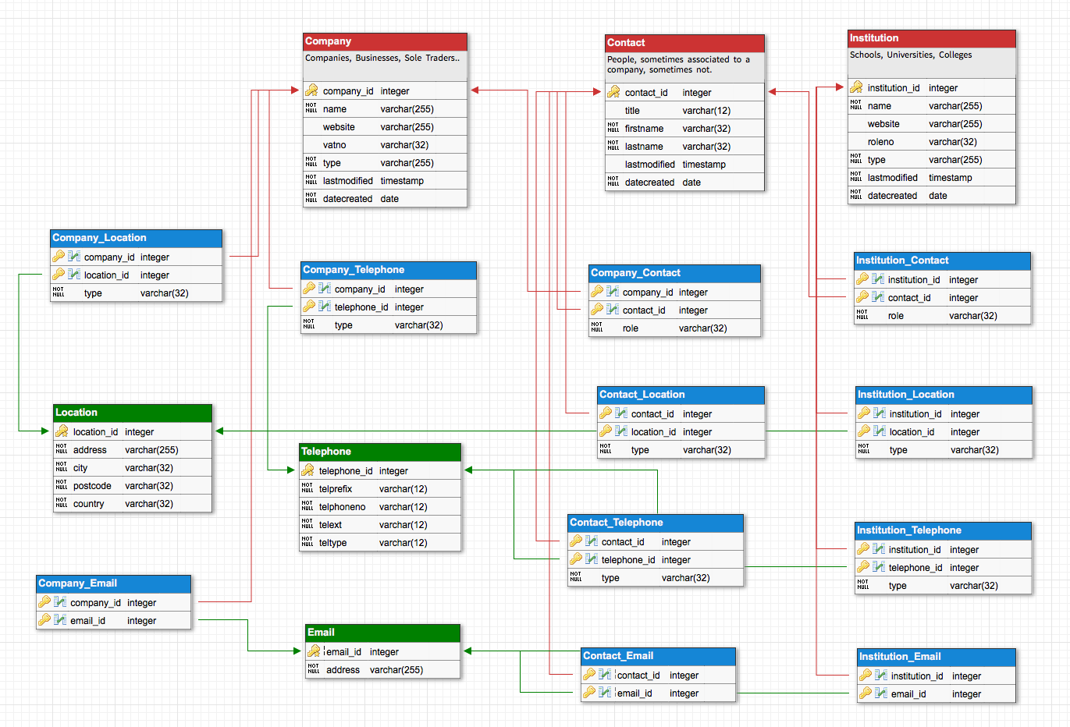
SQL Advantages
Structured Data: Relational databases are really nice when you have a lot of data that needs to be structured in a very specific way, with different sets of data that relate to each other in some way.

Slide 21
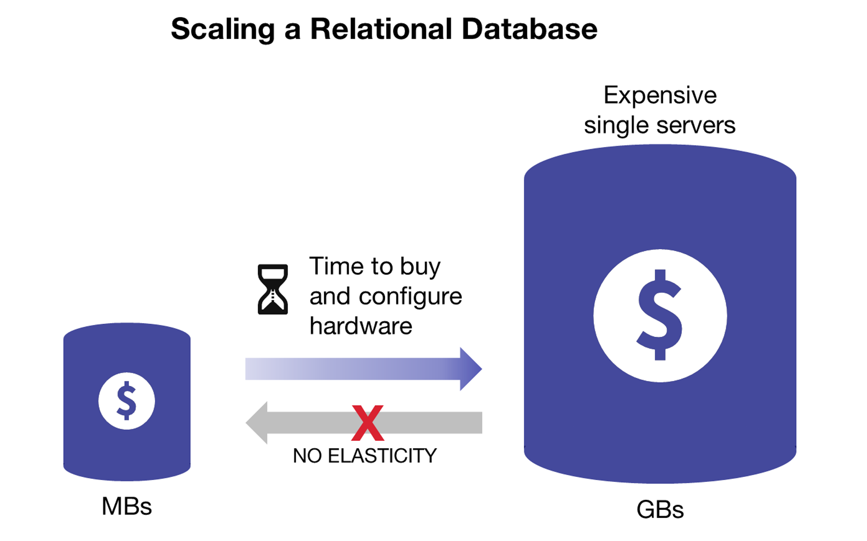
SQL Disadvantages
The main problem with SQL is scaling it as your database grows. You see, even though scalability is usually tested in production environments, it’s often lower than NoSQL databases. Sharding is quite problematic as well.

Slide 22
NOSQL Advantages
Flexible: If your data is not necessarily structured in a certain way, NoSQL databases are a great option. They allow you the flexibility to structure your data in a way that makes the most sense for your application without needing to abide by the row/column format.
Fast: At the cost of ACID compliance, you gain significant speed! Not to say that SQL databases are slow, but by comparison NoSQL databases are much faster when you’re querying them.

Slide 23
NOSQL Advantages
Ease of Use: As you saw above, everything is represented as an object — making them very easy to reason about since we already know how objects work and are structured in programming. As a result, there’s very little learning curve in using these kinds of databases which is nice if you need to get up and running quickly.

Slide 24
NOSQL Disadvantages
A major issue with NoSQL databases is the lack of reporting tools for performance testing and analysis. With SQL, on the other hand, you can find a wide range of reporting tools to help you prove your application’s validity.
There’s a lack of standardization. There are a lot of NoSQL databases and still no standard, like the ones that exist in relational databases. This lack of standardization of NoSQL can cause a problem during migration.

Slide 25
MongoDB

Slide 26
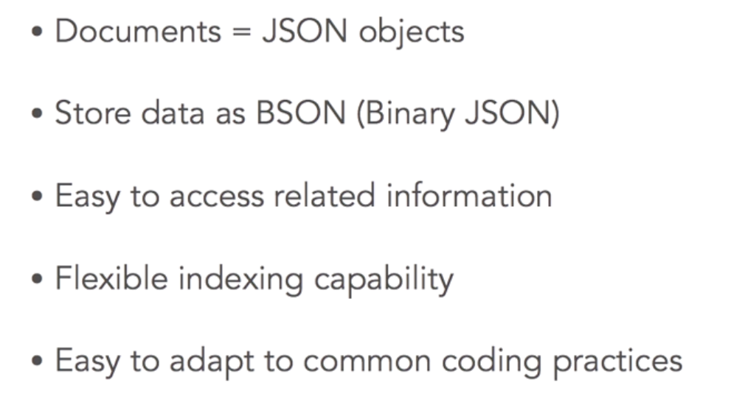
MongoDB

Slide 27
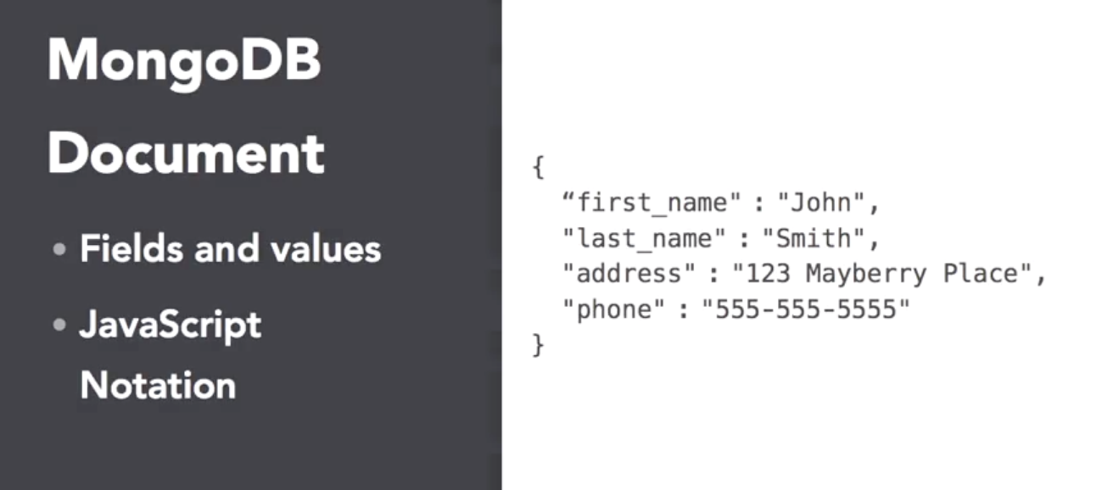

Slide 28
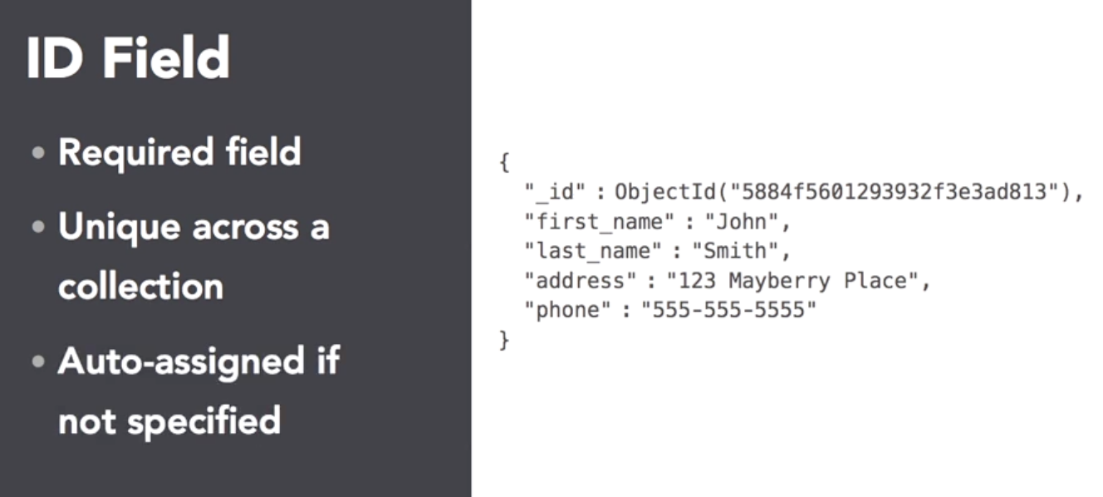

Slide 29
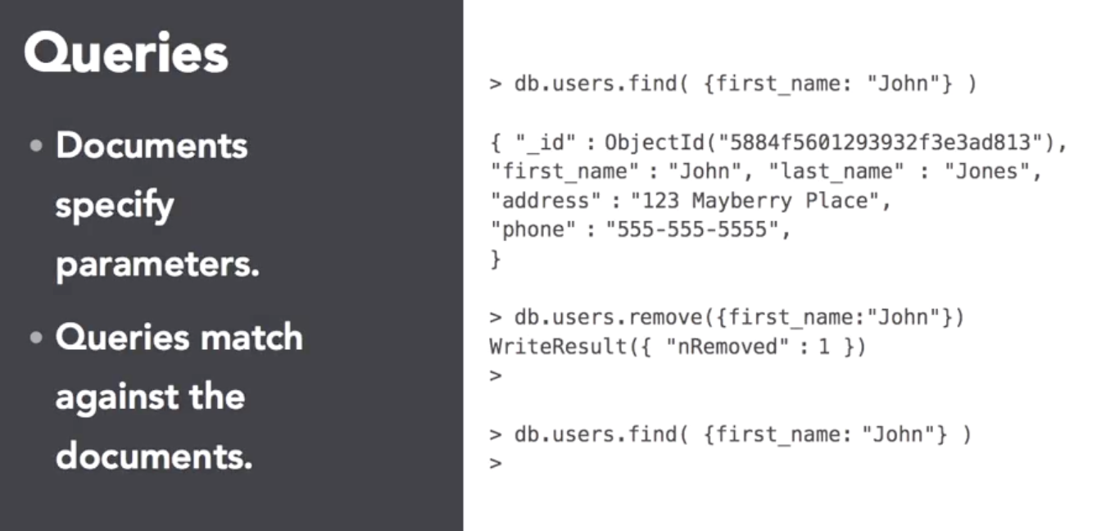

Slide 30
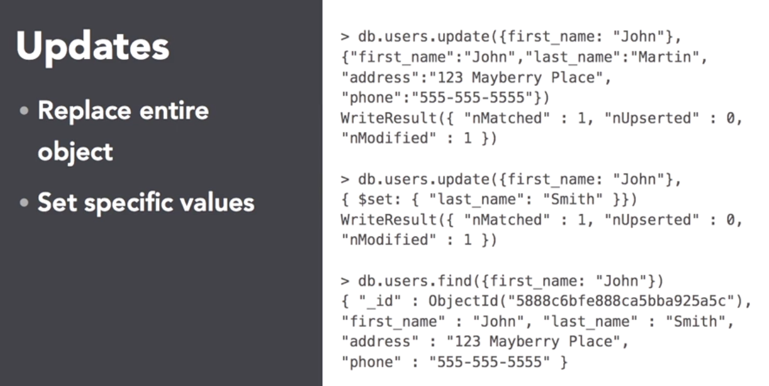

Slide 31
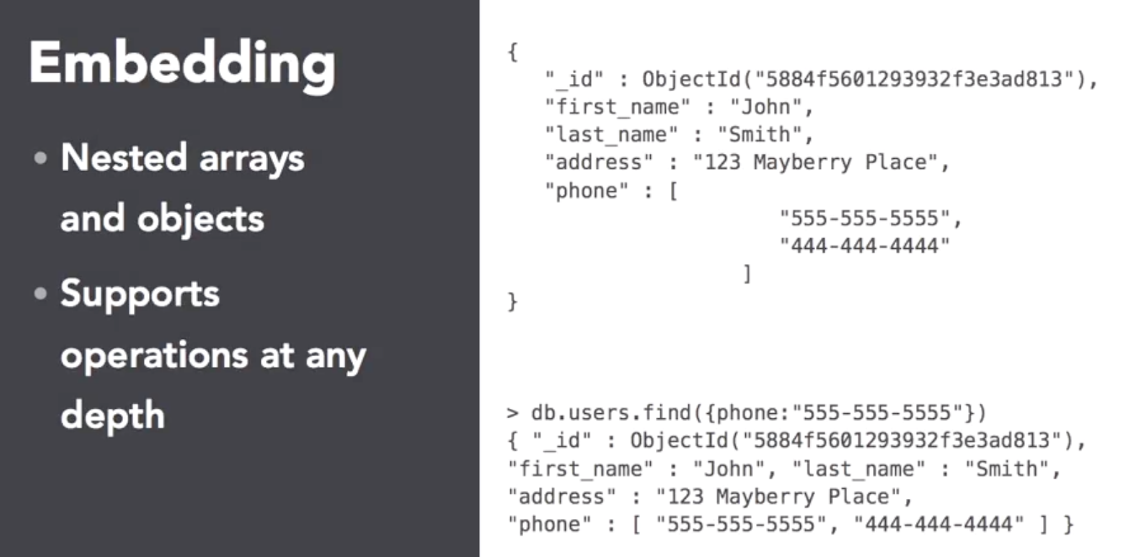

Slide 32
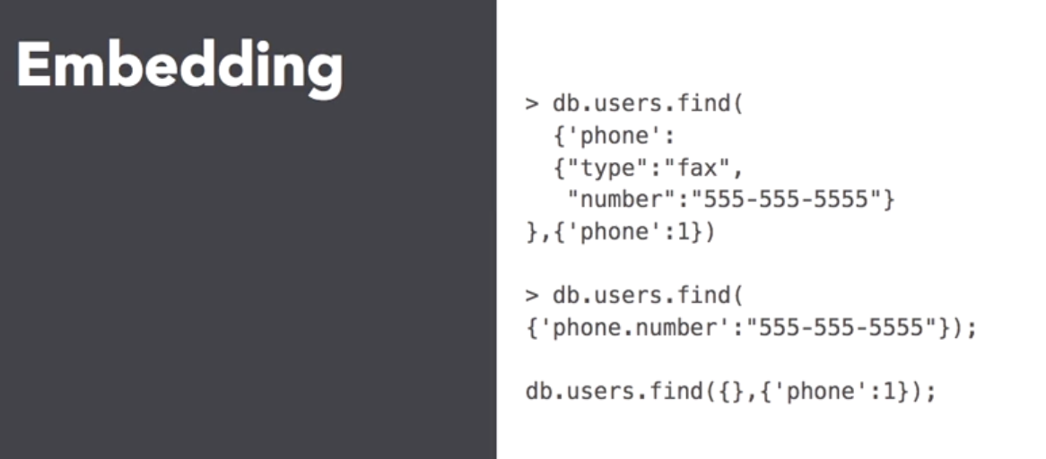

Slide 33
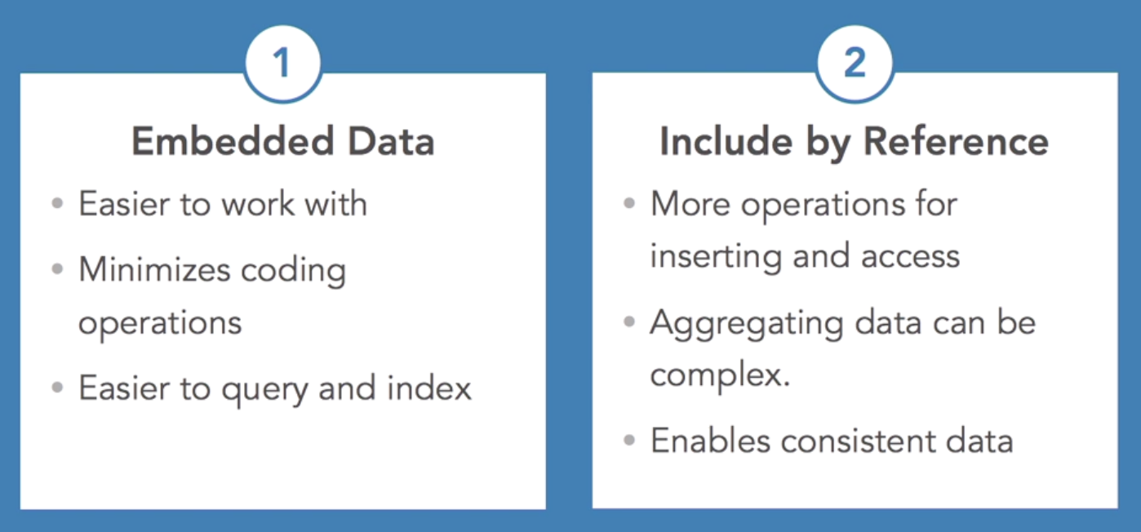

Slide 34
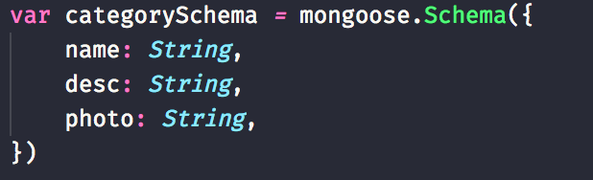
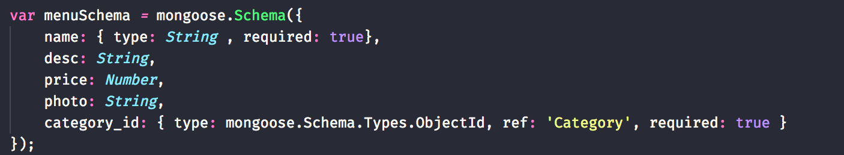
<DefineSchema/>

Slide 35
Example:
Wiki Blog

Slide 36
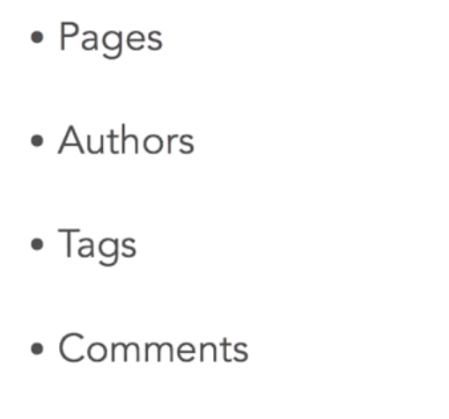
Document Fields

Slide 37
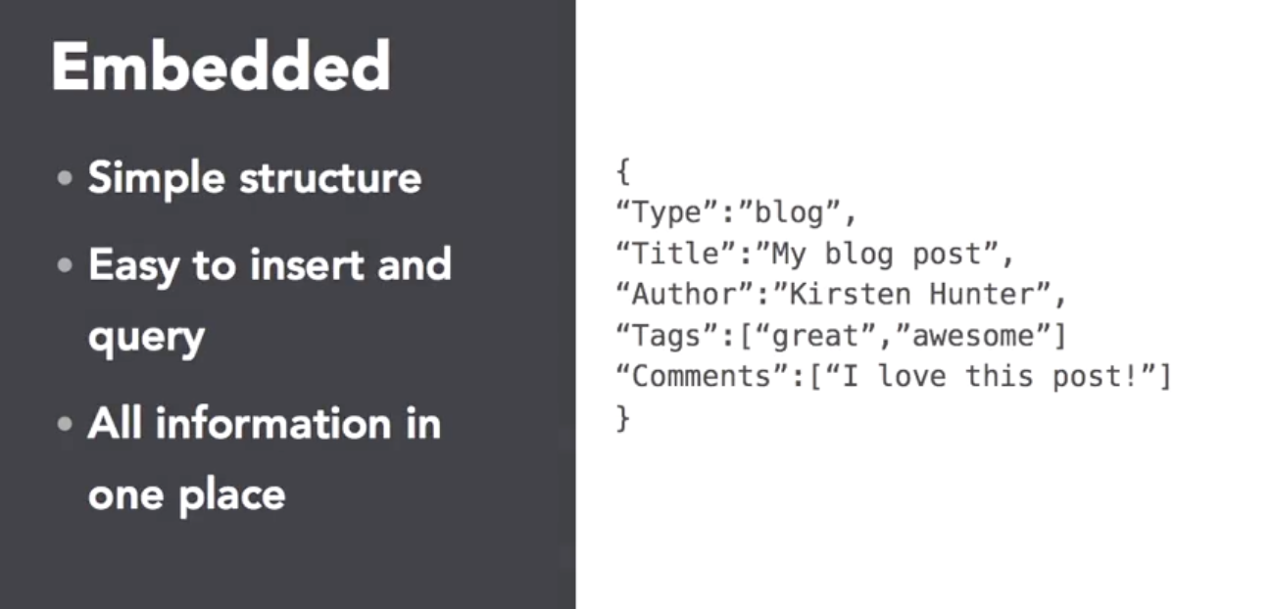

Slide 38
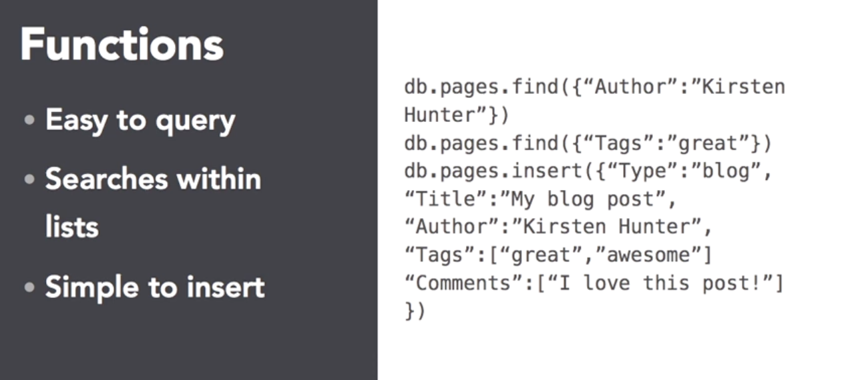

Slide 39
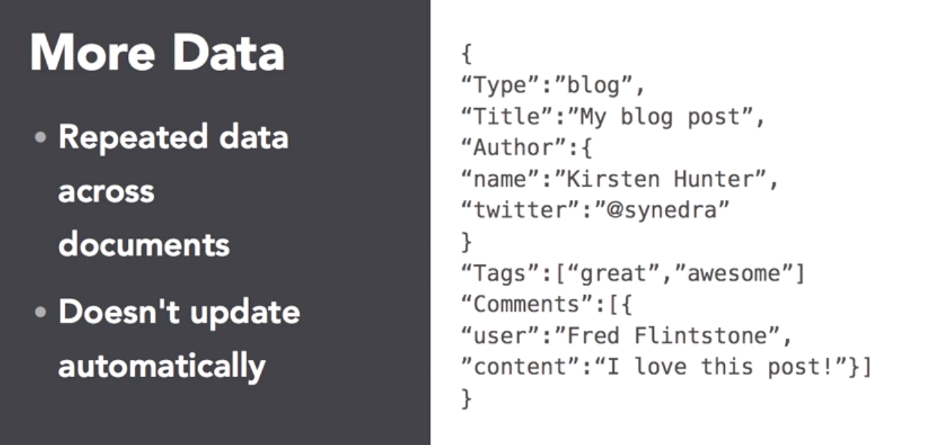

Slide 40
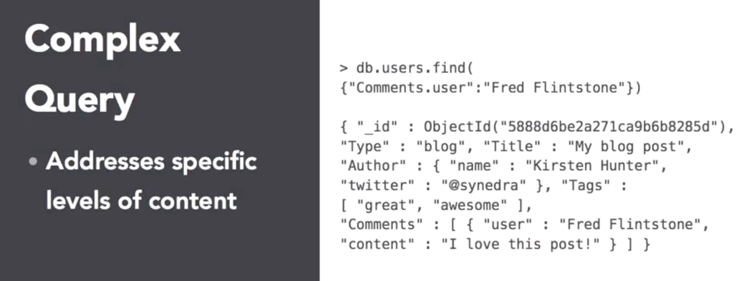

Slide 41
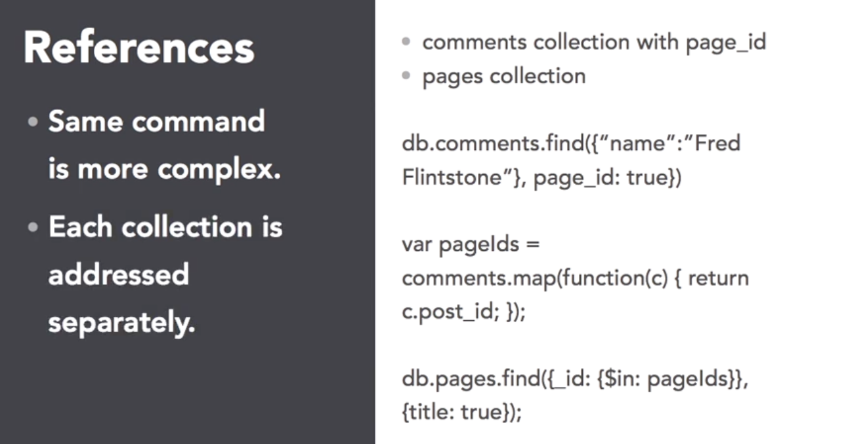

Slide 42
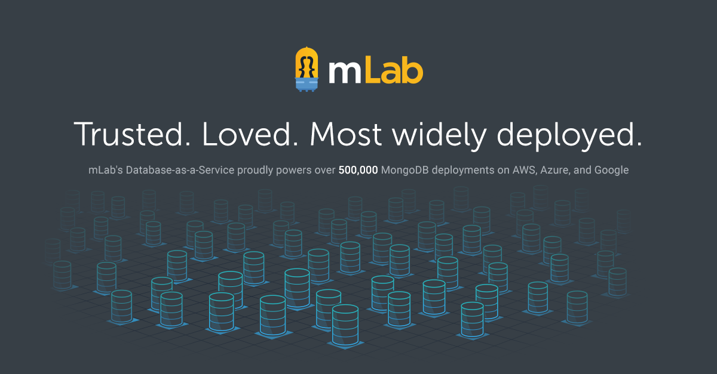
MLAB
https://mlab.com/

Slide 43
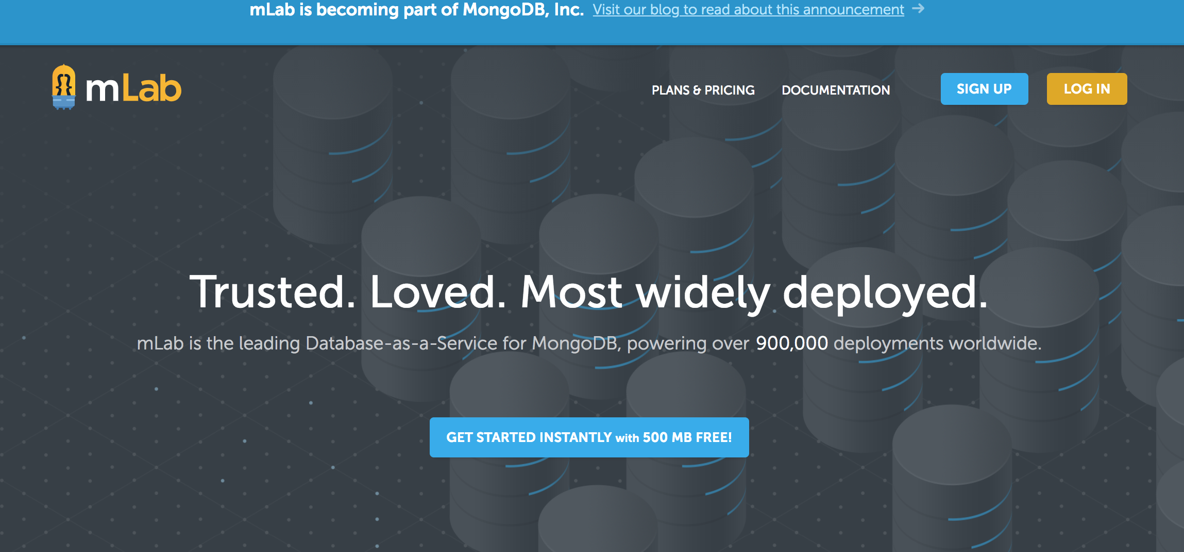

Setup MLAB

Slide 44
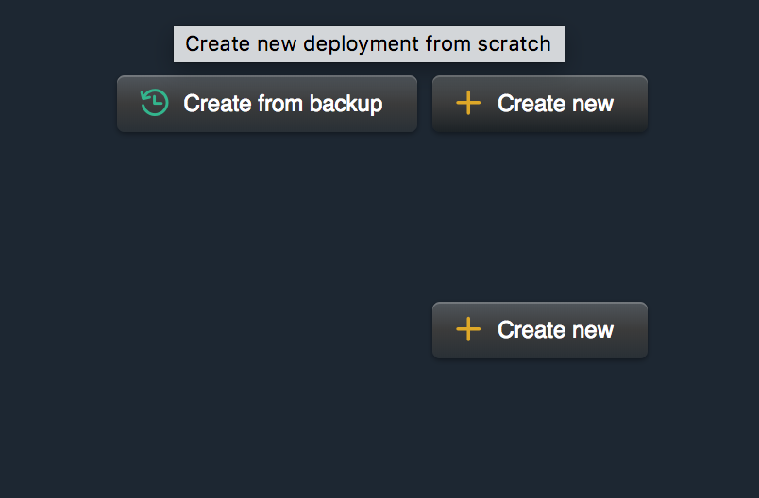
Create DB

Slide 45
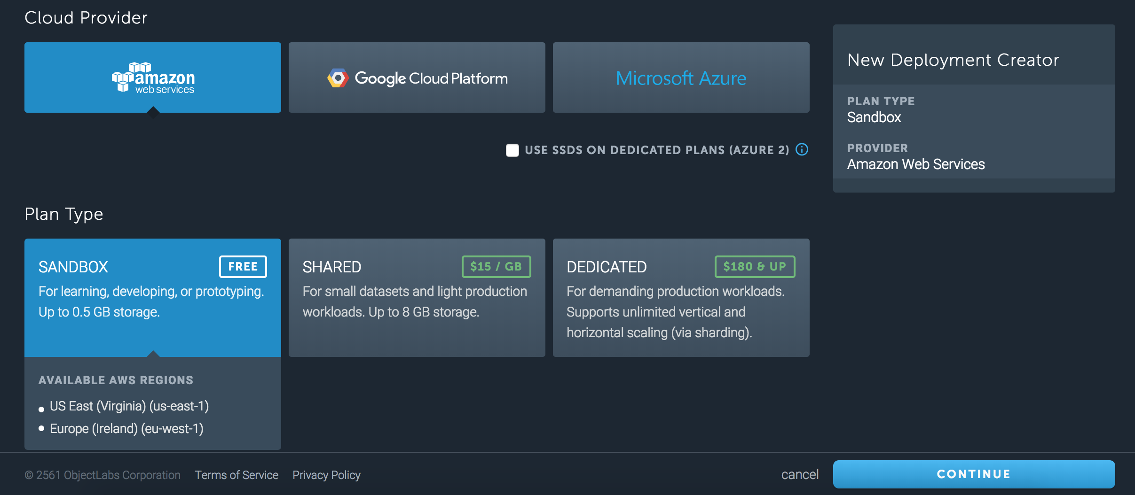
Create DB

Slide 46
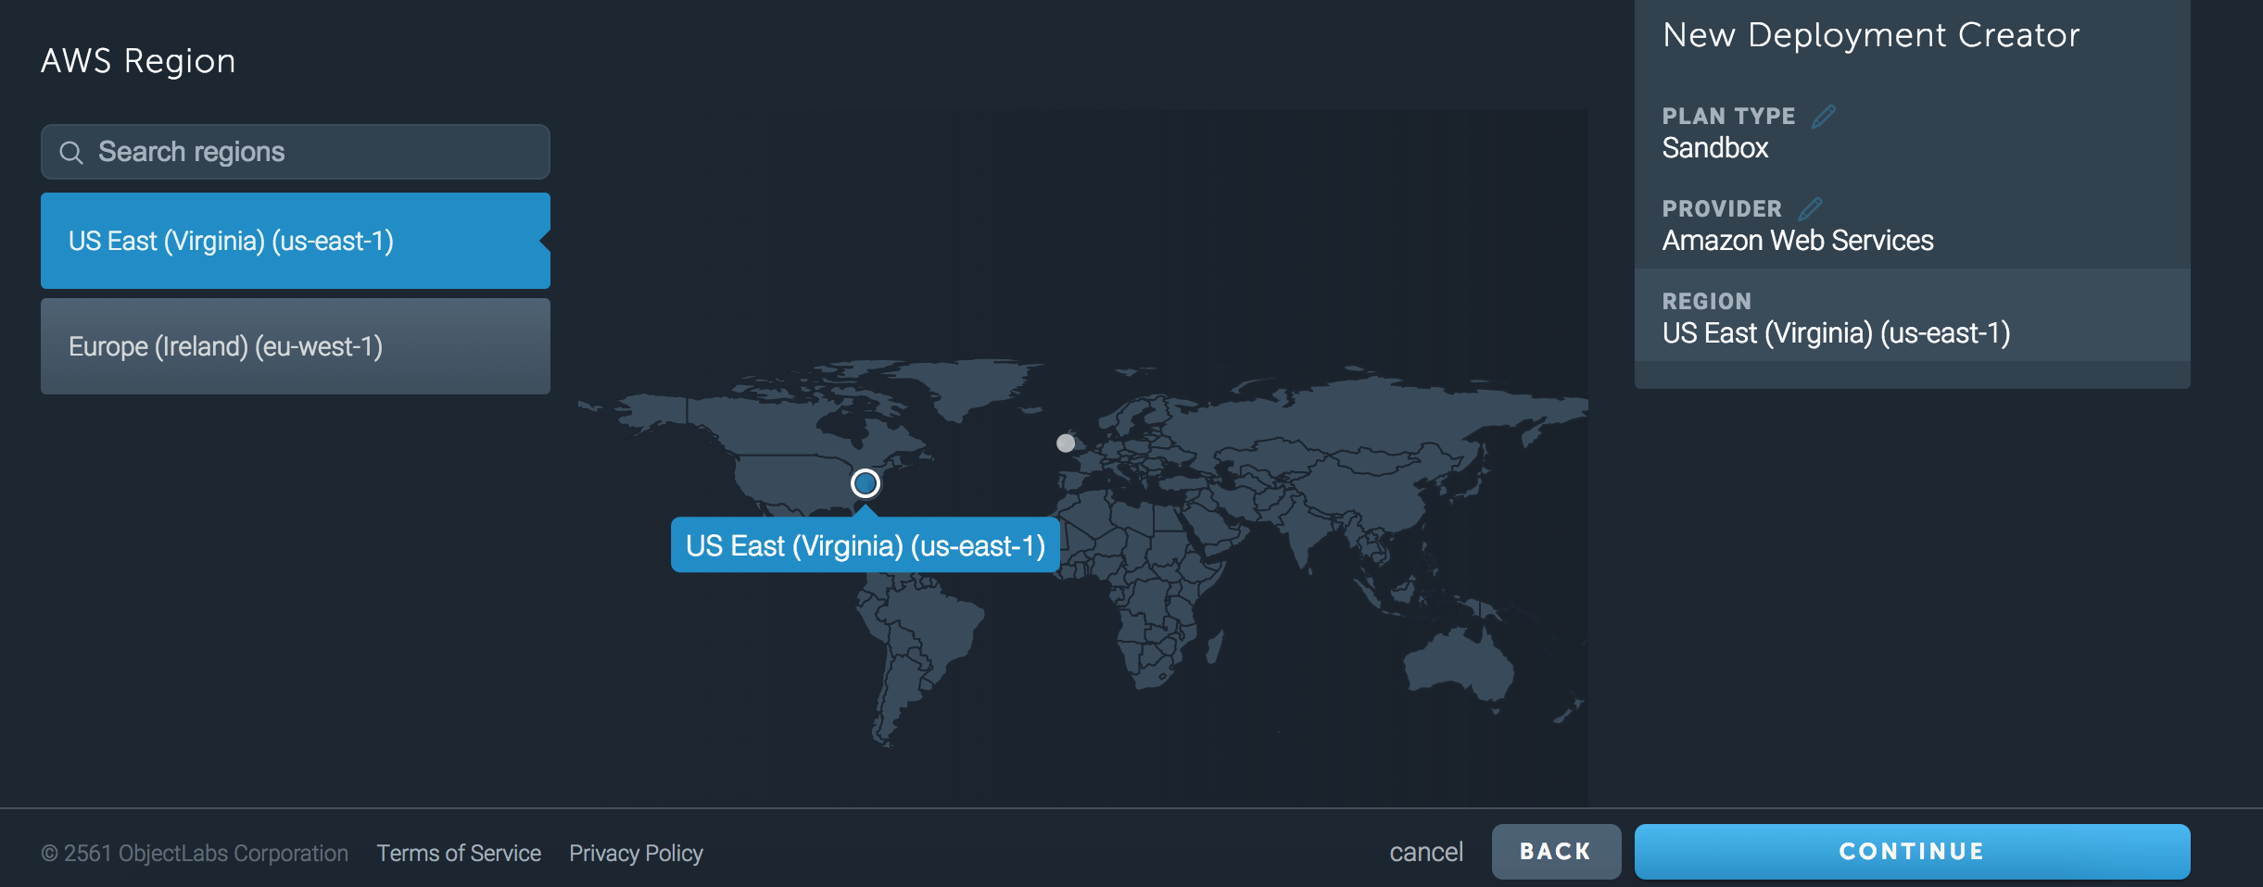
Create DB

Slide 47
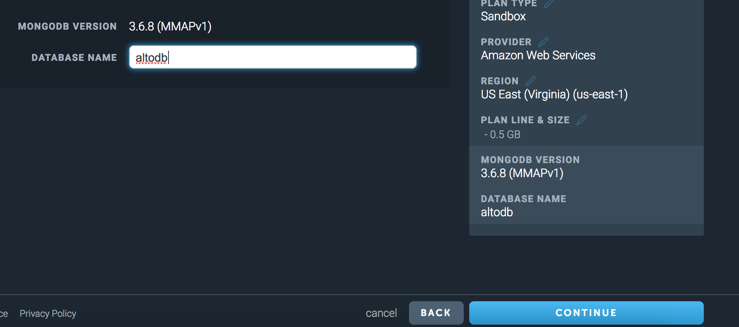
Create DB

Slide 48
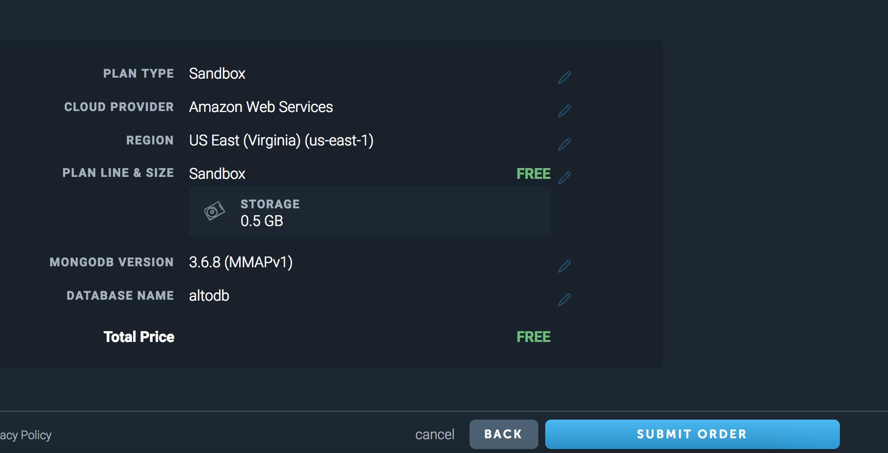
Create DB

Slide 49
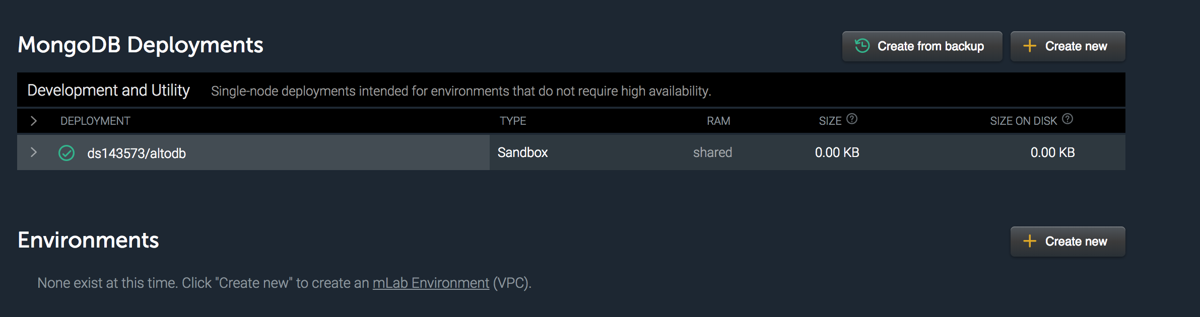
Create DB

Slide 50
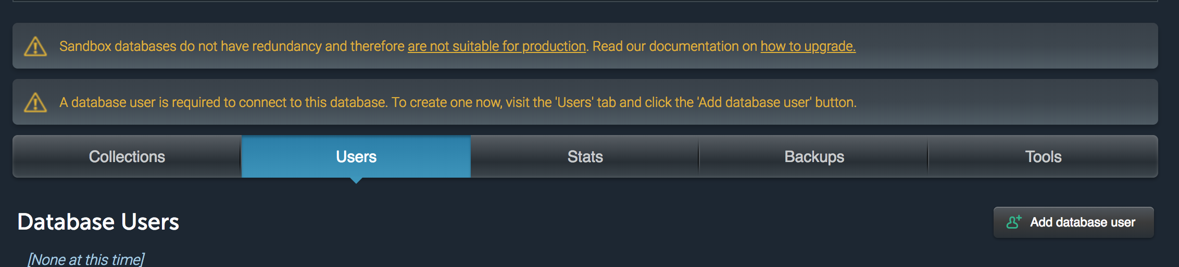
Create DB

Slide 51
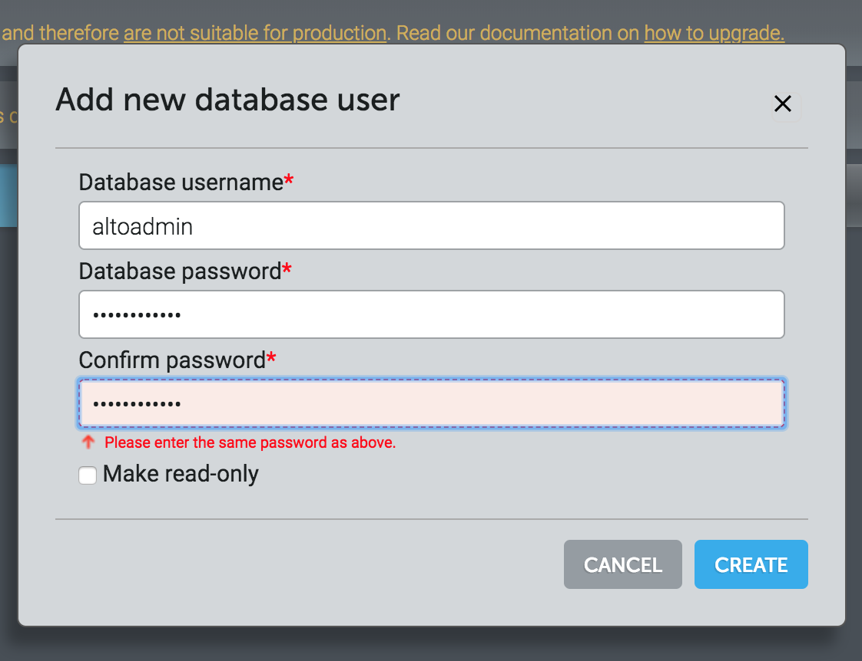
Create DB user

Slide 52
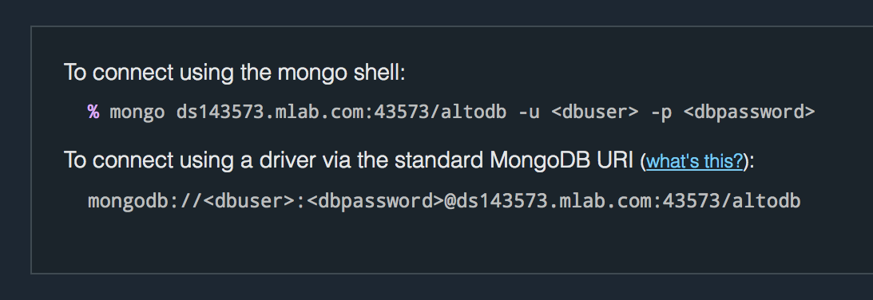
Mongo Credential

Slide 53
https://gist.github.com/h4tl2/b3c91d397dcc0a5c983e0a08de6204a8

Slide 54
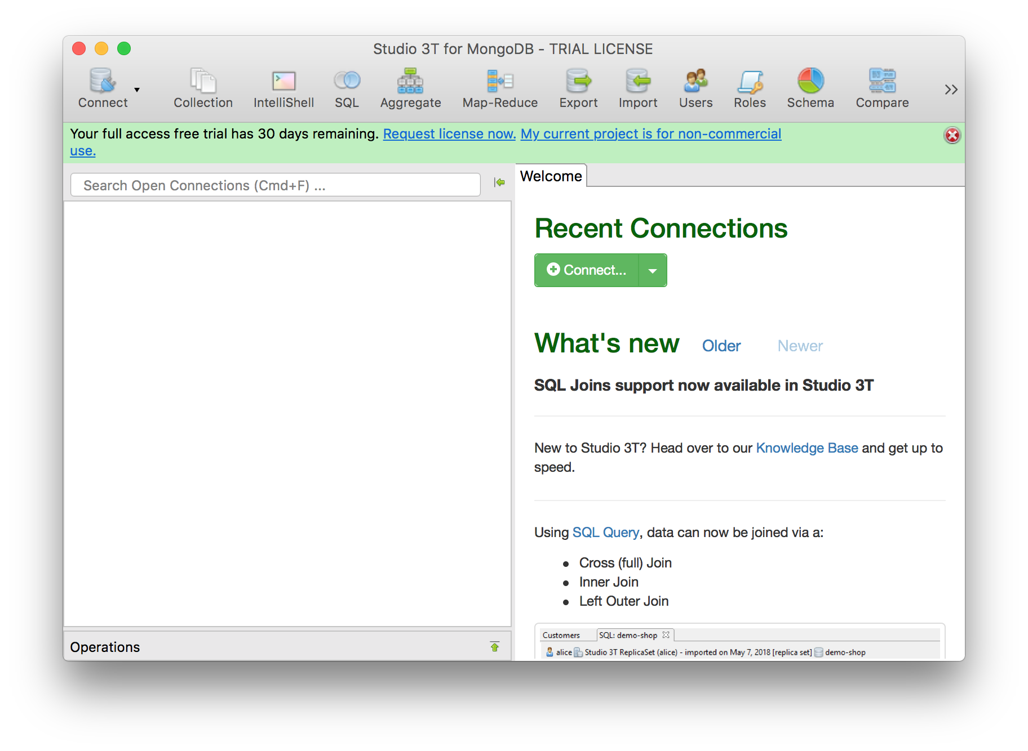
Robo 3T
https://robomongo.org/

Slide 55
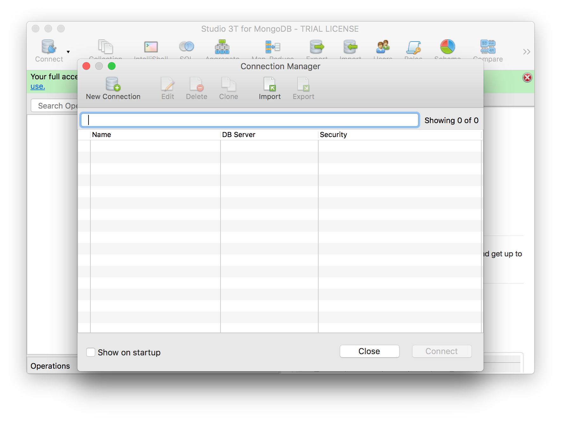
Connect to Mlab

Slide 56
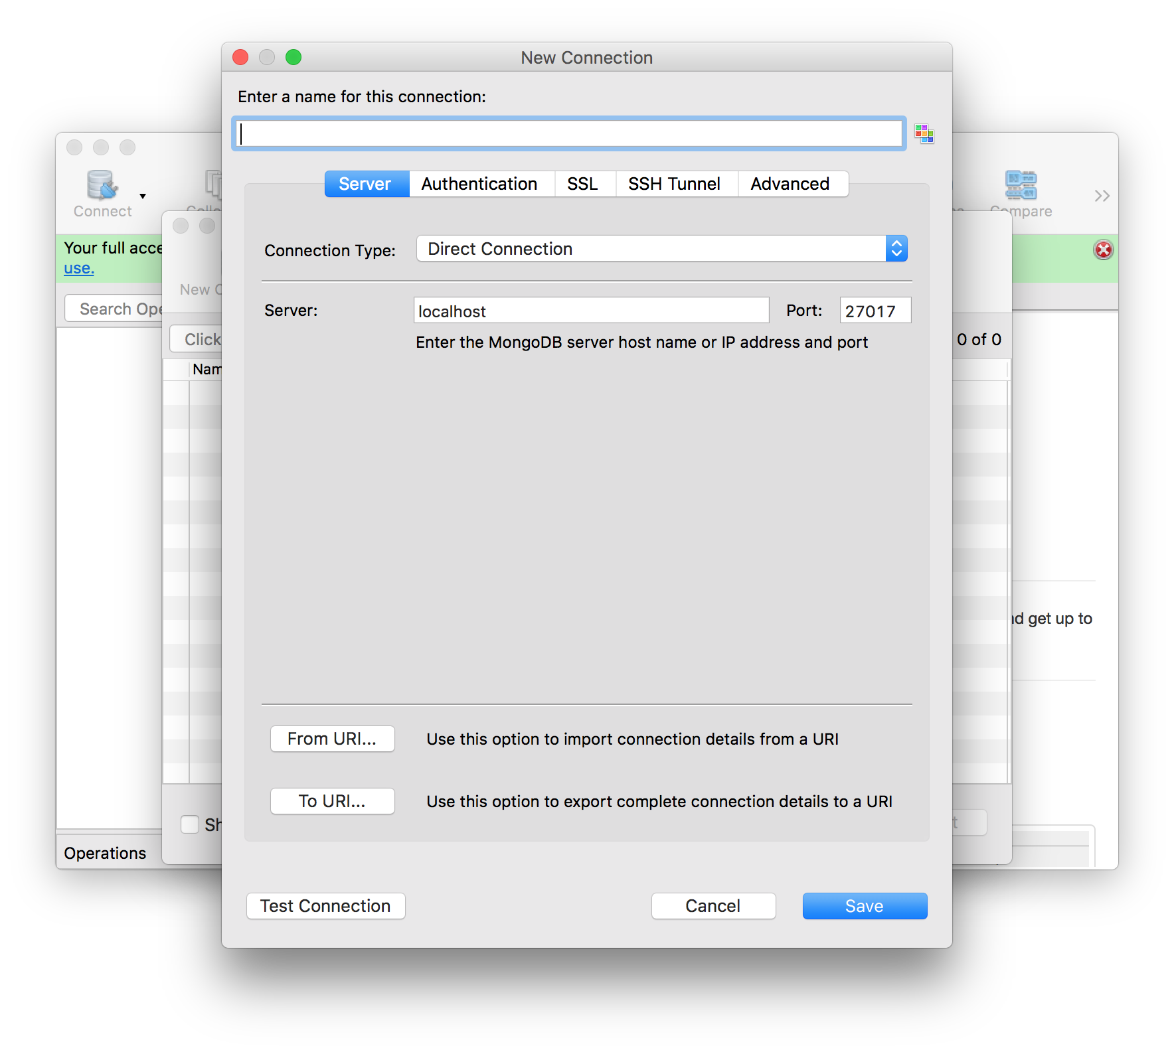

Slide 57
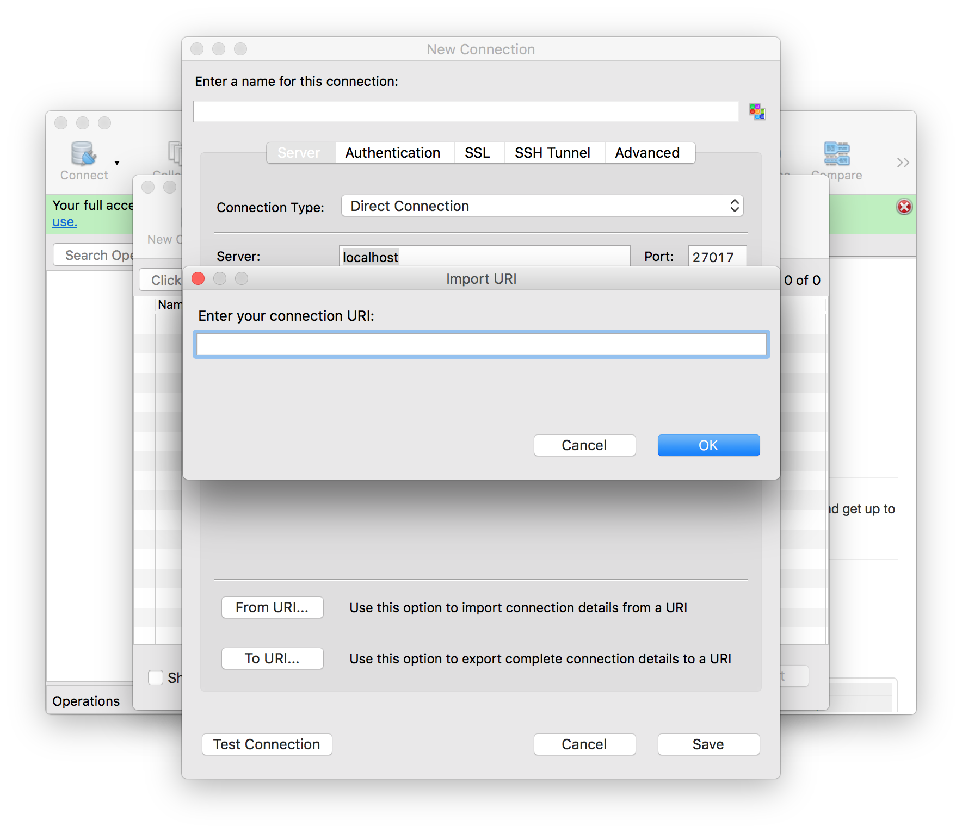

Slide 58
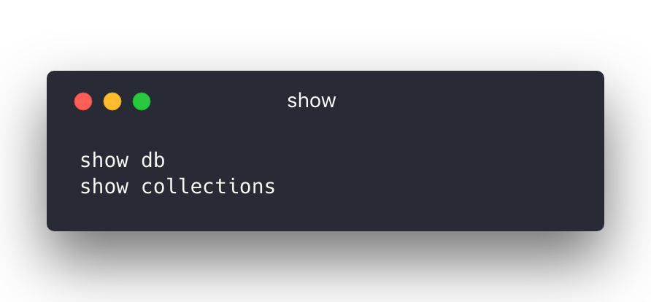

Slide 59


Slide 60
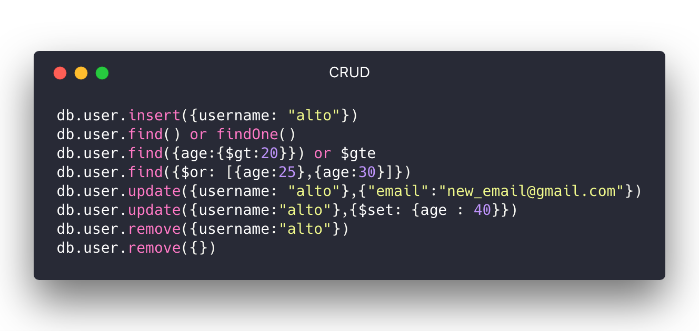

Slide 61


Slide 62


Slide 63
CODE

Slide 64
Example Repository
https://github.com/h4tl2/kbtg-mongo-express

Slide 65
<DefineSchema/>

Slide 66

<Query/>

Slide 67

<Query/>

Slide 68


